Slide 1
ROOMIECONNECT
A Social Media application that helps college students find housing and roommates.

Slide 2
Project Organization
Product Manager: Sampreet Klair
Lead Developer: Harsahbaj Singh
Quality Assurance Specialist: Ritish Sharma

Slide 3
What is RoomieConnect?
RoomieConnect is a platform born out of the challenges faced by students worldwide in finding suitable accommodation or roommates. It aims to simplify the process by providing a centralized hub where students can connect with potential roommates and explore available housing options.
This idea was born out of the challenges faced by some of our teammates who had difficulty finding an accommodation as well as roommate when they recently moved to Canada as an international student.

Slide 4
General Objectives
Enable students to connect with fellow peers who are looking for new rooms or roommates.
Make a transparent process of finding rooms and roommates encouraging students to use our application.
Manage a team of developers and managers to effectively work together synchronously.

Slide 5
Specific Objectives
Personal Verification and Onboarding
Verifying the new users on the sign-in process to ensure that the users are real and not bots.
Making a smooth onboarding experience for new users.
24/7 Support Systems
A support and live chat feature for the users powered by AI to help them navigate through the app.
Matching the Users
Creating an algorithm for connecting compatible users with similar interests as roommates.
Creating an infrastructure that handles the matching process and uses the algorithm in the backend.

Slide 6
Defining Conditions, Constraints, Assumptions and Support Requirements from Other Organizations
The RoomieConnect app needs to be operational by the end of November.
The first phase of this app consists of developing the backend and the frontend development of the application.
The initial versions of this app will only be operational in GTA (Greater Toronto Area) with a scope of further expansion worldwide.
The RoomieConnect is a crucial app for solving the current accommodation crisis, so it is of utmost importance to our beneficiaries which include institutions like University of Toronto, Seneca Polytechnic, York University, and Ontario Student Federation.

Slide 7
Authority and Responsibilities
Staffing – the product manager determined the skill requirements for the RoomieConnect project and provided them, along with specific developer's names, on July 25th to the appropriate functional managers.
Budget – the initial estimate of the project cost was $60,000. This budget cannot be exceeded without authority from the Product Manager and Lead Developer.
Communications – Product Manager and Lead Developer provided and will provide the status reports bi-weekly to the external Sponsors.
Planning/Tracking – this project will be tracked using the MS Project application. An earned value analysis will be provided in every other status report beginning with the second report.
Change Control – the Product manager is authorized to make project changes provided they do not exceed $5,000 in additional cost and do not impact the schedule. Otherwise, any changes will be made through the Management Board which consists of the Product Manager alongside Lead Developer and Quality Assurance specialist.
Document/System Access – the project manager is authorized access to any company document or system related to the current project in the pursuit of this project completion.
Project Plan - The project manager provided a project plan to the Sponsor no later than June 30. The project plan will include a description of the work, schedules, budget, spending plan, resource utilization charts, risk management plans, and a quality plan.

Slide 8
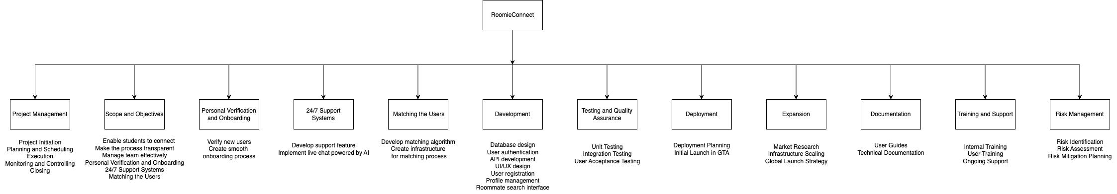
Work Breakdown Structure

Slide 9
WBS Dictionary
WBS Code | Task Title | Detailed Description
1 | Personal Verification and Onboarding | Implementing a verification process to ensure users are real and not bots, enhancing security and trust. Developing a seamless onboarding experience for new users to make sign-up easy and welcoming.
2 | 24/7 Support Systems | Setting up a support system that operates 24/7 to assist users with their queries at any time. Integrating an AI-powered live chat feature to provide instant support and help users navigate the app.
3 | Matching the Users | Creating an algorithm to match users with compatible roommates based on similar interests.
4 | Development | Integrating the matching algorithm into the backend infrastructure for efficient processing. Designing the user interface (UI) to ensure its user-friendly and visually appealing.
5 | Deployment | Setting up the database to store user data securely and efficiently. Initializing the deployment process for our app so that the users can experience it.
6 | Expansion | Conducting user experience (UX) testing to identify and fix any usability issues. Managing servers to ensure the app runs smoothly and handles user load effectively.
7 | Documentation | Using MS Project to plan and track project progress, ensuring adherence to timelines. Managing changes in the project scope, schedule, and cost through an established change control process.
8 | Training and Support | Hiring and onboarding employees with the required skill set to fill the human resource we need. Training and conduction knowledge transfer to the new e
9 | Testing | Developing a comprehensive testing plan to ensure all features work as intended.
10 | Risk Management | Identifying and fixing bugs that arise during testing phases.

Slide 10
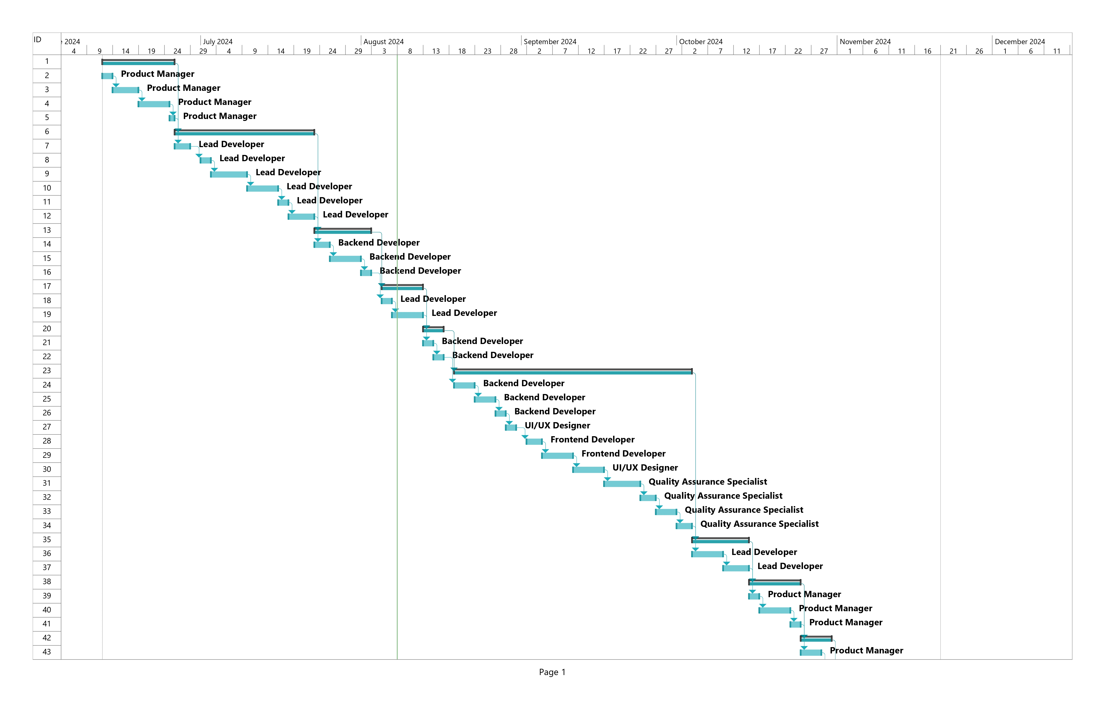
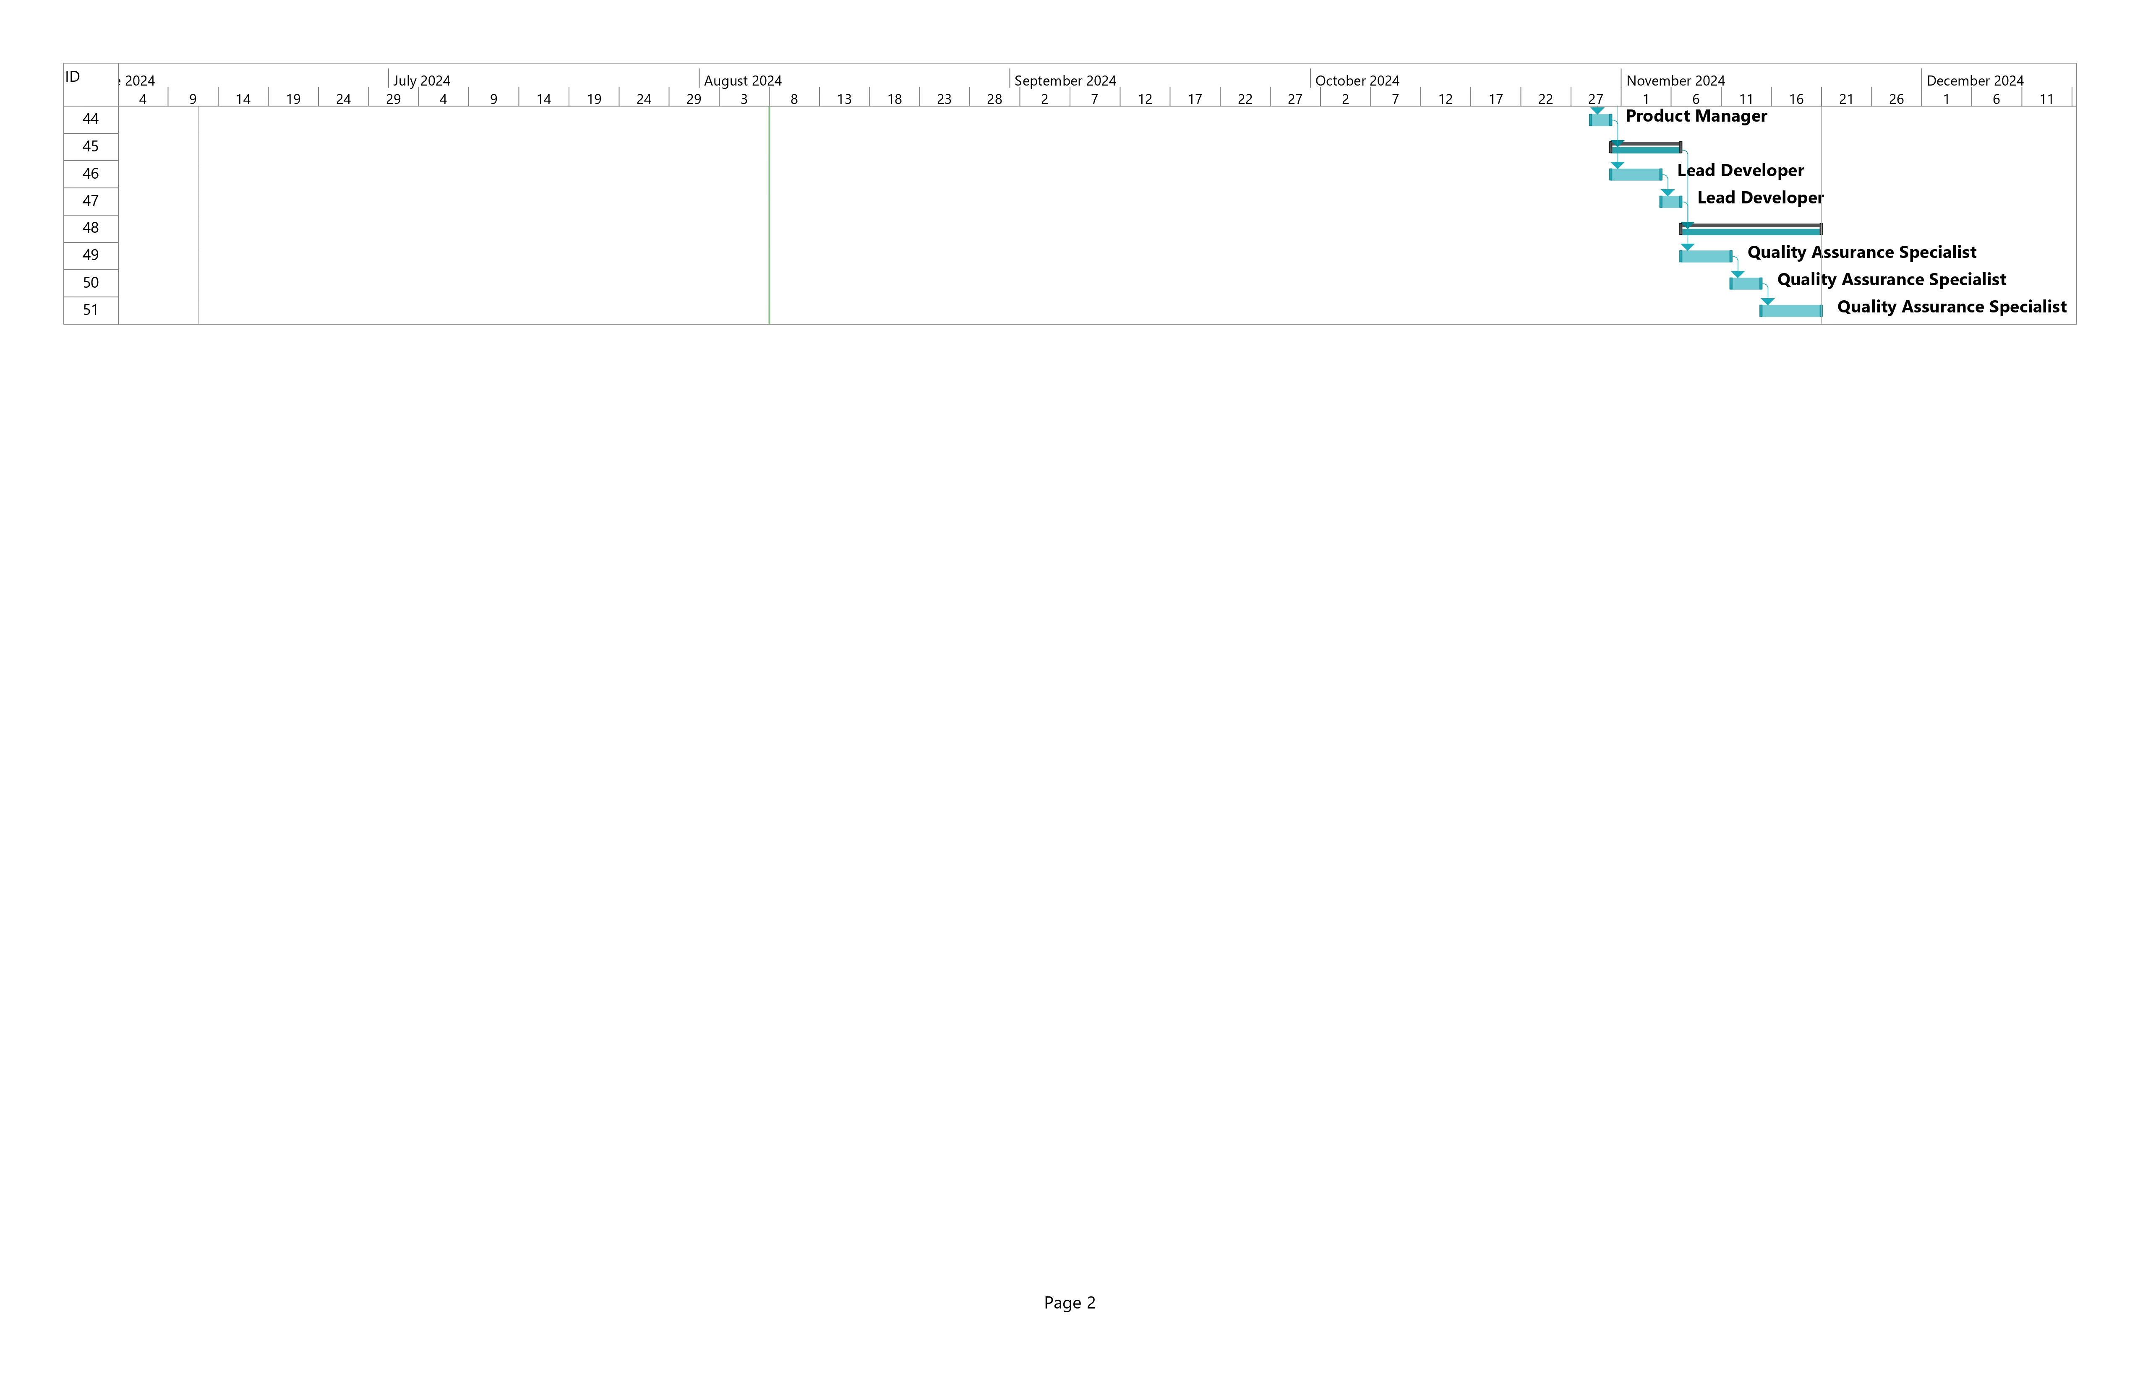
Gantt Chart

Slide 11
Major Project Activities
Backend Development: Setting up databases, user verification systems, and algorithm implementation for user matching.
Frontend Development: Designing the user interface, integrating user onboarding processes, and implementing support features.
Testing and Quality Assurance: Conducting rigorous testing to ensure app functionality and security, overseen by the QA specialist.
Team Collaboration: Coordinating across different roles—product manager, developers, UI/UX designer, and QA specialist—to ensure seamless integration of all components.

Slide 12
Project Assessment
Outcomes: The initiative effectively delivered a working platform that aligned with the outlined goals, such as user authentication, seamless onboarding, and efficient user pairing.
Success:
Created a strong backend infrastructure to facilitate AI-driven functionalities.
Achieved successful user matches through the implemented algorithm.
Challenges: Faced setbacks in frontend development due to unexpected challenges, but these issues were addressed by allocating extra resources and extending timelines.
Reflection: Overall, the project was a success, meeting most of the original objectives, though some features like global expansion were deferred for future versions.

Slide 13
Summary of Risks
Identified Risks:
User Verification Issues: Initial challenges with fake profiles and bot detection were resolved by enhancing our verification algorithms.
Technical Difficulties: Unexpected backend integration problems caused delays in project timelines; these were tackled by redistributing team resources and adjusting deadlines.
Budget Constraints: The project stayed within the $60,000 budget, although vigilant oversight was necessary due to unforeseen software expenses.
Risk Management:
Ongoing monitoring and strategic resource reallocation played a crucial role in managing risks, ensuring the project was completed on time and within budget.

Slide 14
List of Prioritized Risks
Resource Availability: Potential delays if key personnel are unavailable.
Budget Overruns: Risk of exceeding the $60,000 budget.
Technical Issues: Unexpected challenges in development, particularly in matching algorithms.
User Adoption: Risk that the platform does not attract sufficient users.

Slide 15
Milestone Reports
Project Initiation: Completed as planned.
Backend Development: On track with database and API development.
User Onboarding System: Successfully implemented and tested.
Deployment in GTA: Planned for completion by the end of November.
Post-Launch Evaluation: Planned for two weeks post-launch to assess initial user feedback and system performance.

Slide 16
Documents’ Interrelationships Clear
Business Case provides the rationale behind the project.
Project Charter outlines the scope, objectives, and team.
Team Charter defines roles, responsibilities, and processes.
Scope Statement details the project’s boundaries and deliverables.
WBS and WBS Dictionary breaks down the project tasks.
Gantt Chart tracks the schedule and progress.
Risk List identifies and prioritizes potential challenges.
Milestone Reports provide status updates and guide project adjustments.

Slide 17
Lessons Learned (Insights & Suggestions)
Importance of Clear Communication
Flexibility in Project Management
User-Centered Design
Risk Management
Team Collaboration and Resource Allocation
Documentation and Process Tracking

Slide 18
Conclusion
The RoomieConnect project was developed to address the challenge students face in finding suitable accommodation and compatible roommates.
The team successfully created a platform that connects students with potential roommates and housing options.
Despite encountering technical difficulties, the project was completed on budget and met most goals, including user verification and AI-powered support.
RoomieConnect is now ready to serve students in the Greater Toronto Area, with plans for future expansion.
The foundation built promises future growth, making RoomieConnect a valuable tool for students worldwide.

Slide 19
Thank YOU…

